Slide 1
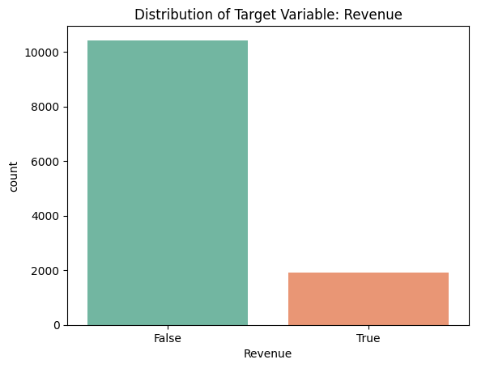
Predicting Online Purchasing Intention
Class Imbalance
Right-skewed distributions and extreme values
Purchasing intention is not directly observable
Data Leakage
The goal of this project is to predict whether an online user session will result in a purchase.
Each observation represents a single browsing session, and the target variable indicates whether a transaction occurred.
Challenge
Modeling pipeline
Feature engineering, preprocessing, resampling, and model training in a leakage-safe manner
The main challenge of this task is severe class imbalance

Slide 2
Feature Groups
Behavioral Intensity: TotalPages: total number of pages visited, TotalDuration: total time spent during the session
Interaction Efficiency: AvgAdminTime, AvgInfoTime, AvgProdTime, AvgTimePerPage
Intent Signal Strength: PageValuesPerDuration, PageValuesPerPage, HasPageValues
Bounce & Exit Interaction: ExitMinusBounce, ExitTimesBounce
Business Context Encoding: IsSpecialDay, Weekend_int
Split dataset
Training set: model learning 70%
Validation set: model selection and threshold tuning 15%
Test set: final unbiased evaluation 15%
Numerical Processing(Yeo-Johnson)
Categorical Encoding(one-hot)
Class Imbalance Handling(SMOTE )
Encapsulated into a unified pipeline

Slide 3
Model Benchmarking and Hyperparameter Tuning
Tuning Strategy: RandomizedSearchCV
Evaluation Metric: F1
Random Forest — ensemble of decision trees best CV F1 ≈ 0.68
XGBoost — gradient boosting decision trees best CV F1 ≈ 0.67
Multi-Layer Perceptron (MLP) — neural network–based classifier best CV F1 ≈ 0.64
Validation Results & Decision Threshold Optimization
Model | Threshold | Precision (Class 1) | Recall (Class 1) | F1 (Class 1) | Accuracy | Δ F1
Random Forest | 0.50 (default) | 0.7685 | 0.9056 | 0.8315 | 0.9432 | —
 | 0.665 (tuned) | 0.8945 | 0.8007 | 0.8450 | 0.9546 | +0.0135
XGBoost | 0.50 (default) | 0.6559 | 0.7133 | 0.6834 | 0.8978 | —
 | 0.575 (tuned) | 0.6901 | 0.6853 | 0.6877 | 0.9038 | +0.0043
MLP | 0.50 (default) | 0.5440 | 0.8217 | 0.6546 | 0.8659 | —
 | 0.680 (tuned) | 0.6258 | 0.7133 | 0.6667 | 0.8897 | +0.0121

Slide 4
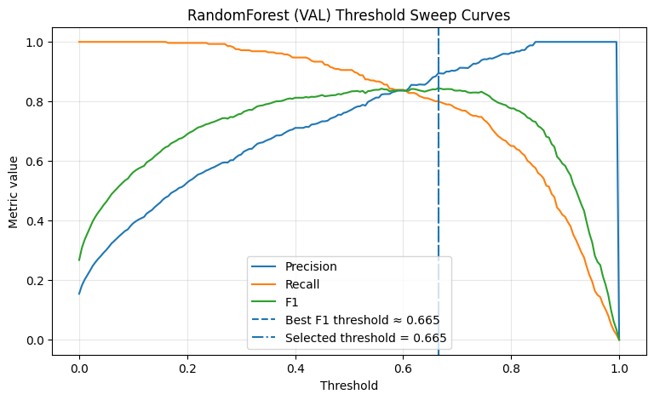
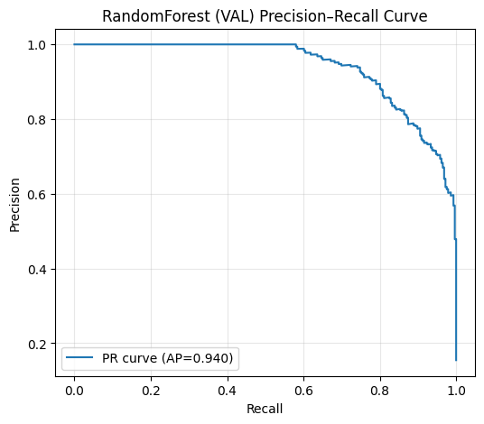
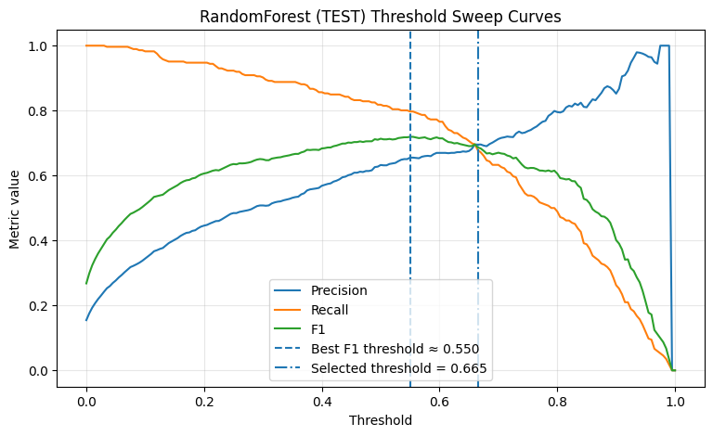
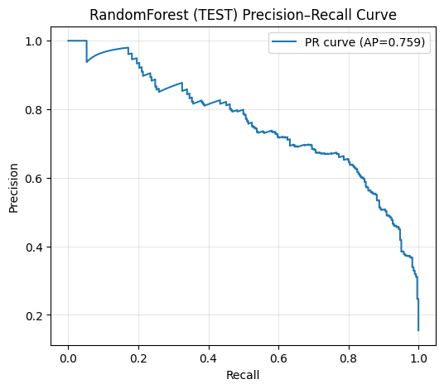

Slide 5
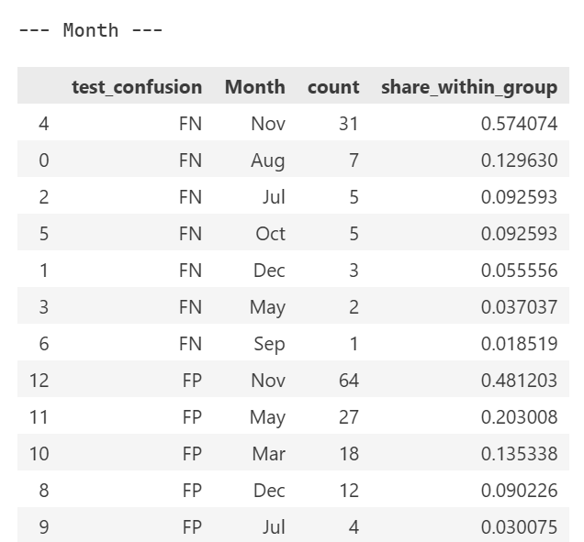
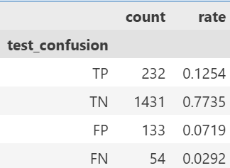
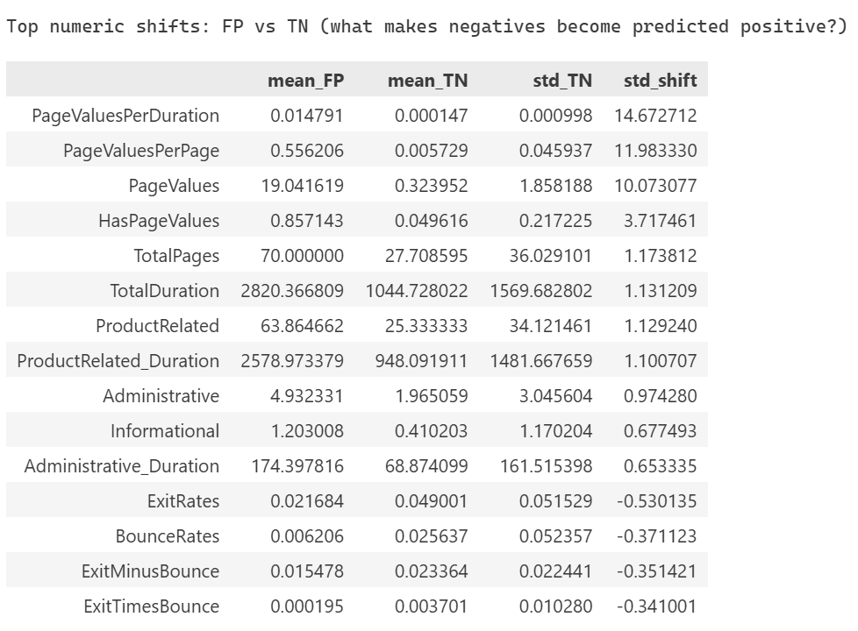
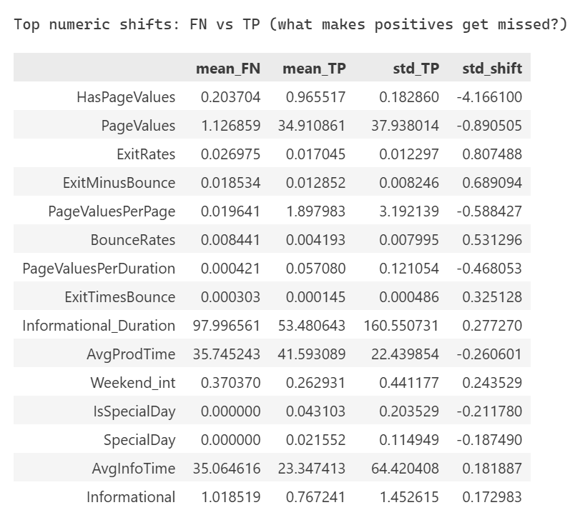
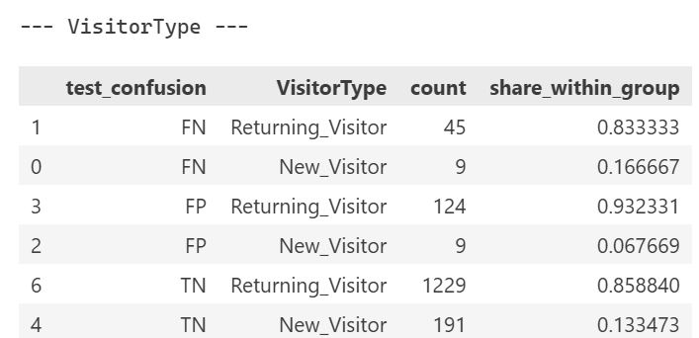
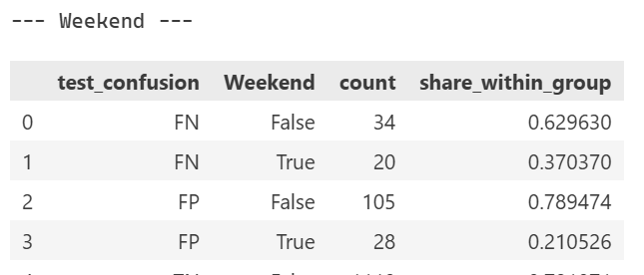
Error Analysis & Model Diagnostics
True Positives (TP)
True Negatives (TN)
False Positives (FP)
represent wasted marketing efforts
False Negatives (FN)
represent missed revenue opportunities

Slide 6
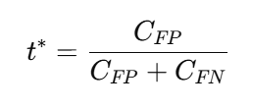
For cost-based decision-making, probability magnitude matters, not just ranking.
I wrapped the trained Random Forest using CalibratedClassifierCV with isotonic regression and internal cross-validation.
WHEN
COST_FP = 1
COST_FN = 5 we have
≈ 0.24
Policy / Strategy | Threshold Strategy | Precision (Class 1) | Recall (Class 1) | F1 (Class 1) | Accuracy | Expected Cost (TEST)
Global cost-optimal | Global threshold = 0.240 | 0.6026 | 0.8112 | 0.6915 | 0.8881 | 423.0
Month-segmented | Month-specific thresholds (VAL-optimized) | 0.6261 | 0.7727 | 0.6917 | 0.8935 | 457.0
VisitorType-segmented | VisitorType-specific thresholds | 0.6063 | 0.8077 | 0.6927 | 0.8892 | 425.0
Policy P4 (Nov-only + shrinkage) | Global + November shrinkage | 0.6026 | 0.8112 | 0.6915 | 0.8881 | 423.0

Slide 7
Business Insight
High-intent sessions exhibit consistent behavioral patterns that can be detected before conversion.
Many false positives are not noise, but high-intent sessions that failed to convert due to external frictions.
Model accuracy alone is not actionable.
Decision thresholds directly control business trade-offs.
False negatives are significantly more costly than false positives in e-commerce.

